Slide 1
SUPERSTORE SALES
EXCEL PROJECT
PRABIN P
DA&DS

Slide 2
PROJECT OVERVIEW
Analyze sales data to identify trends, improve performance, and provide insights.
GOALS
Data Cleaning
Automate Tasks Using Macros
Create Pivot Table
Make Dashboard

Slide 3
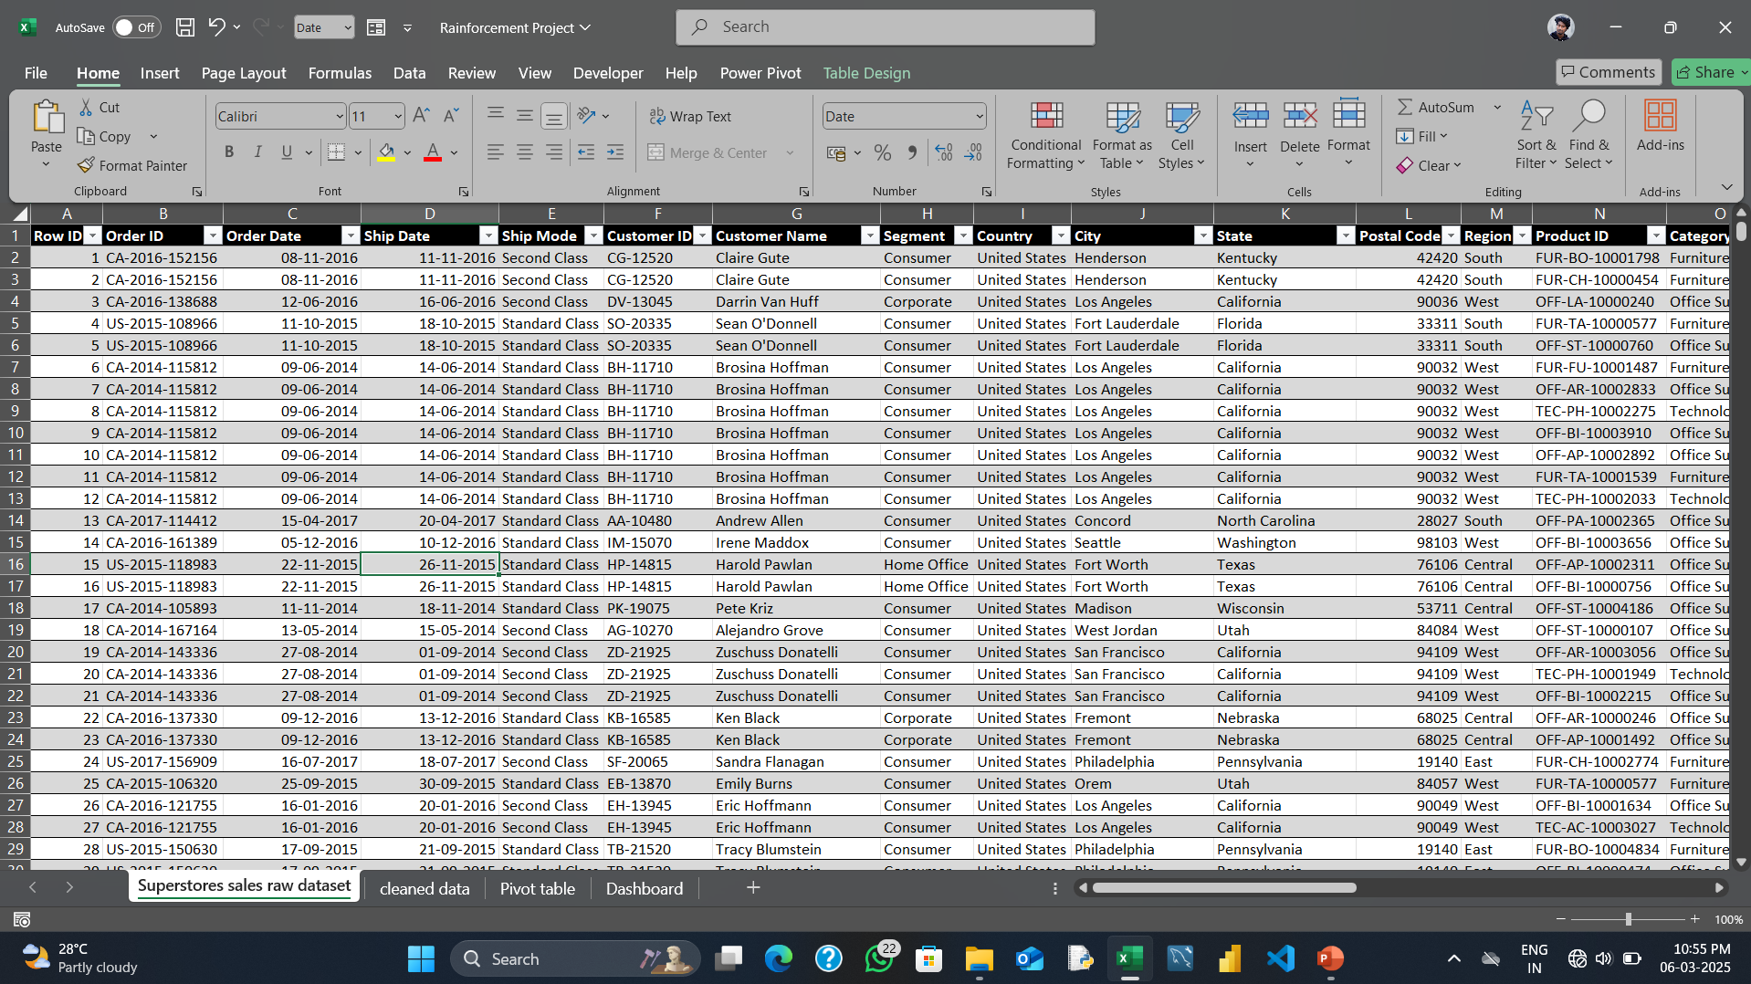
DATA CLEANING
Raw Data
Raw data contains lot of unnecessary information, lot of duplicate values, order date and shipped date formats and more…

Slide 4
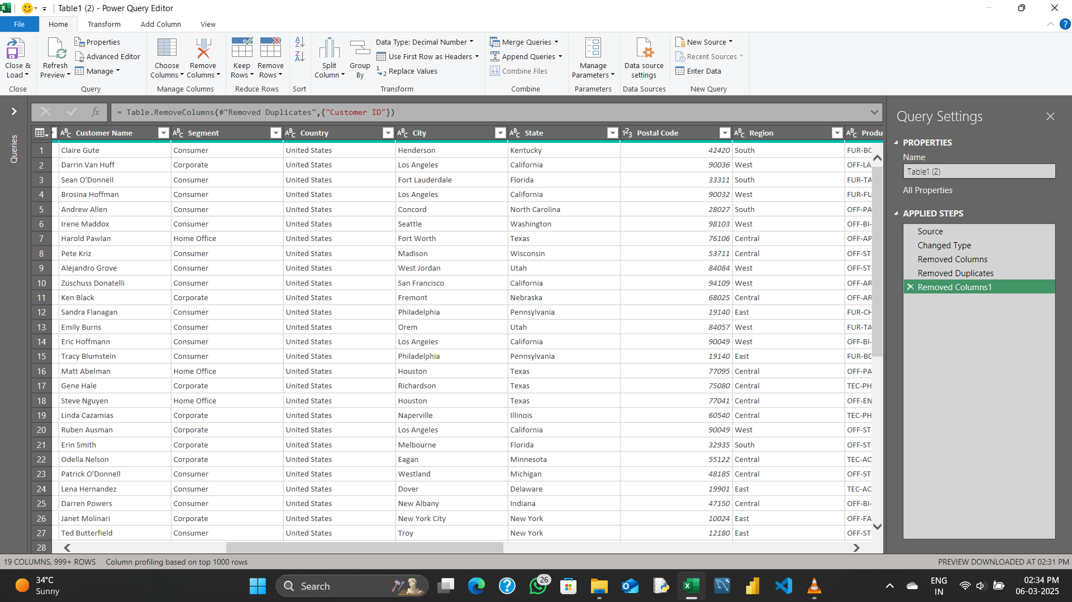
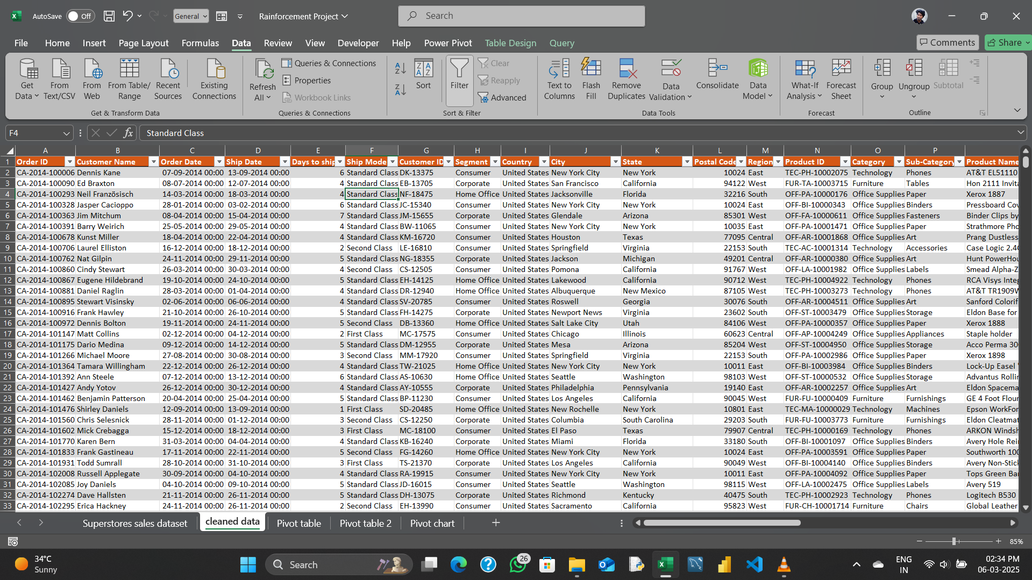
Power Query Editor
After Using Power Query Editor
Power Query Editor is used for clean this type of larger dataset.
Before had 9995 rows in the raw file.
We have 5010 rows of data after remove the duplicate value based on Order ID.
Unwanted columns and duplicate values are removed by using power query editor.

Slide 5
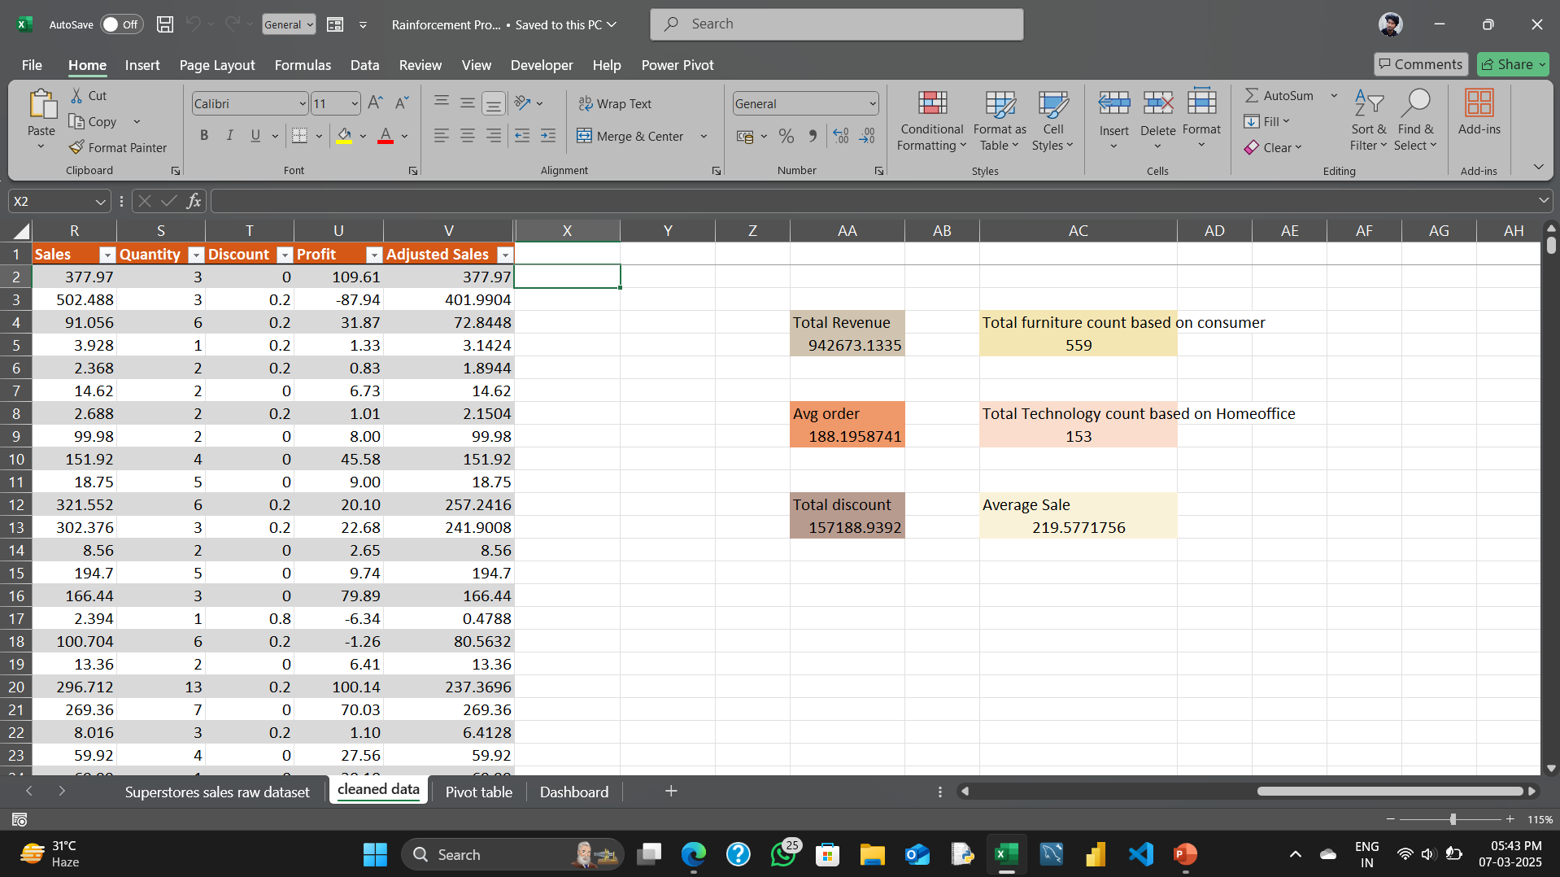
Formulas
Some simple formulas are used for find the maximum values minimum values sum of the columns.
Adjusted Sales, Separate products counts and some extra details are get by using formulas.

Slide 6
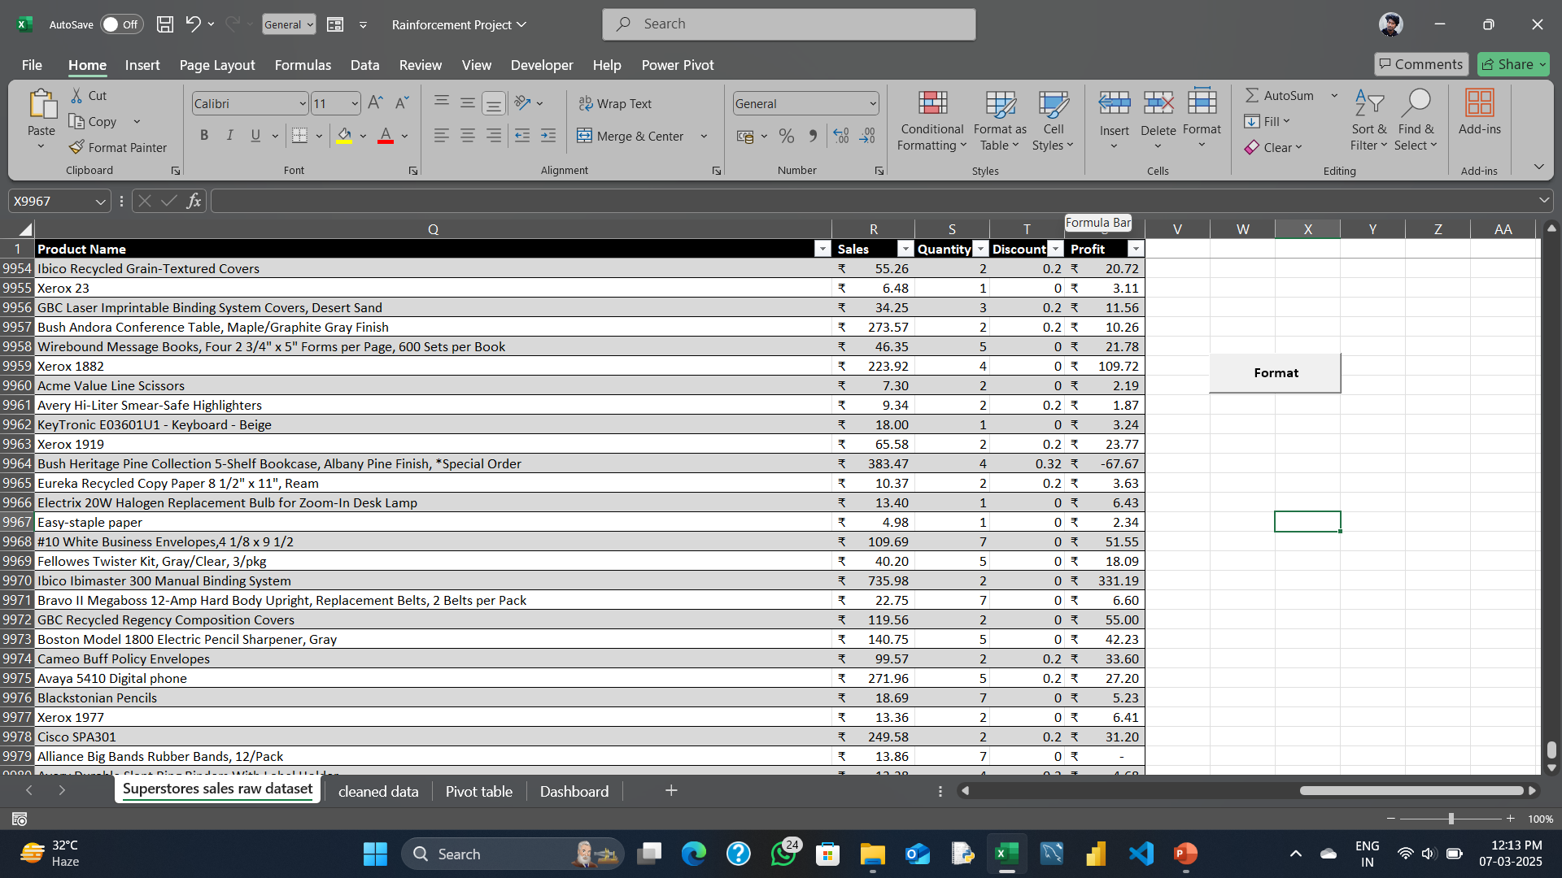
MACRO
A macro in Excel is a recorded sequence of actions or a set of instructions that automate repetitive tasks.
I used macro is,
Bold and freeze the header,
Proper alignment,
Sale and profit values convert to currency value.

Slide 7
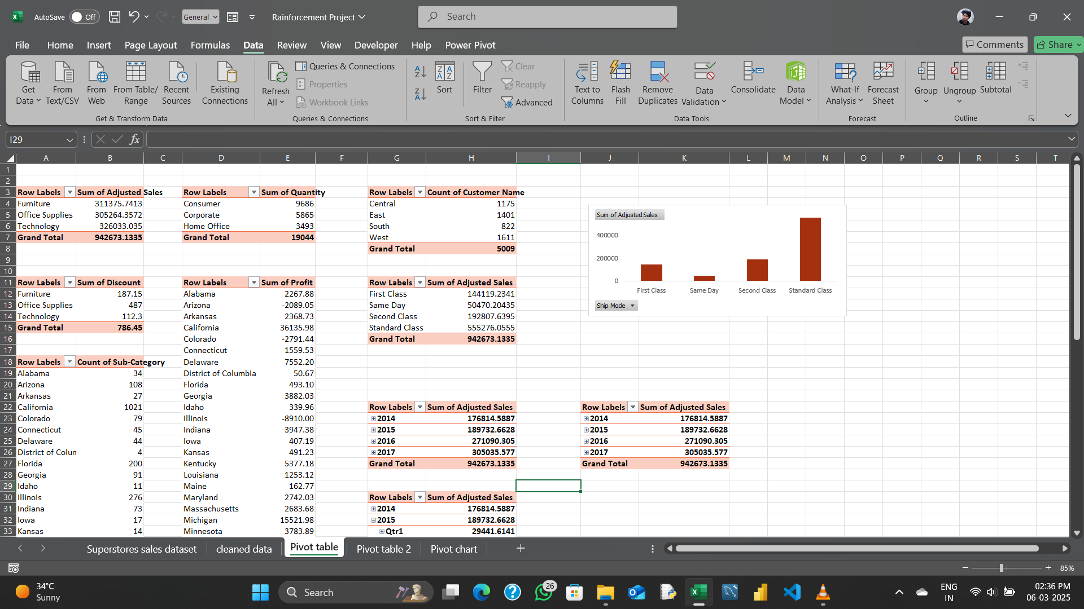
PIVOT TABLE
A pivot table is a table of values which are aggregations of groups of individual values from a more extensive table within one or more discrete categories.
Year wise sale,
Category wise Discount,
State wise Sub-Category Count,
Segment wise selling Quantity,
Region wise customer count and State wise profit.
They are used for improve the sale and profit.

Slide 8
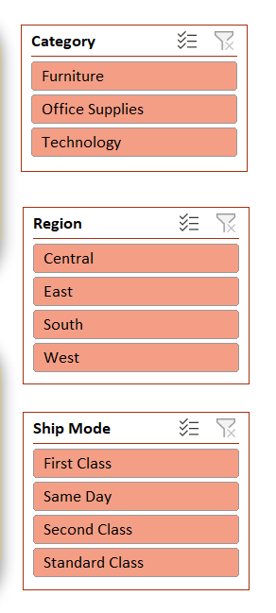
SLICER
A Slicer in Excel is a visual filter that allows users to quickly and easily filter data in PivotTables, PivotCharts, or tables. Slicers provide buttons that you can click to filter data instead of using traditional dropdown filters, making it more intuitive and user-friendly.
Category
Region
Ship Mode
These three slicers enough for our superstore sales dashboard.

Slide 9
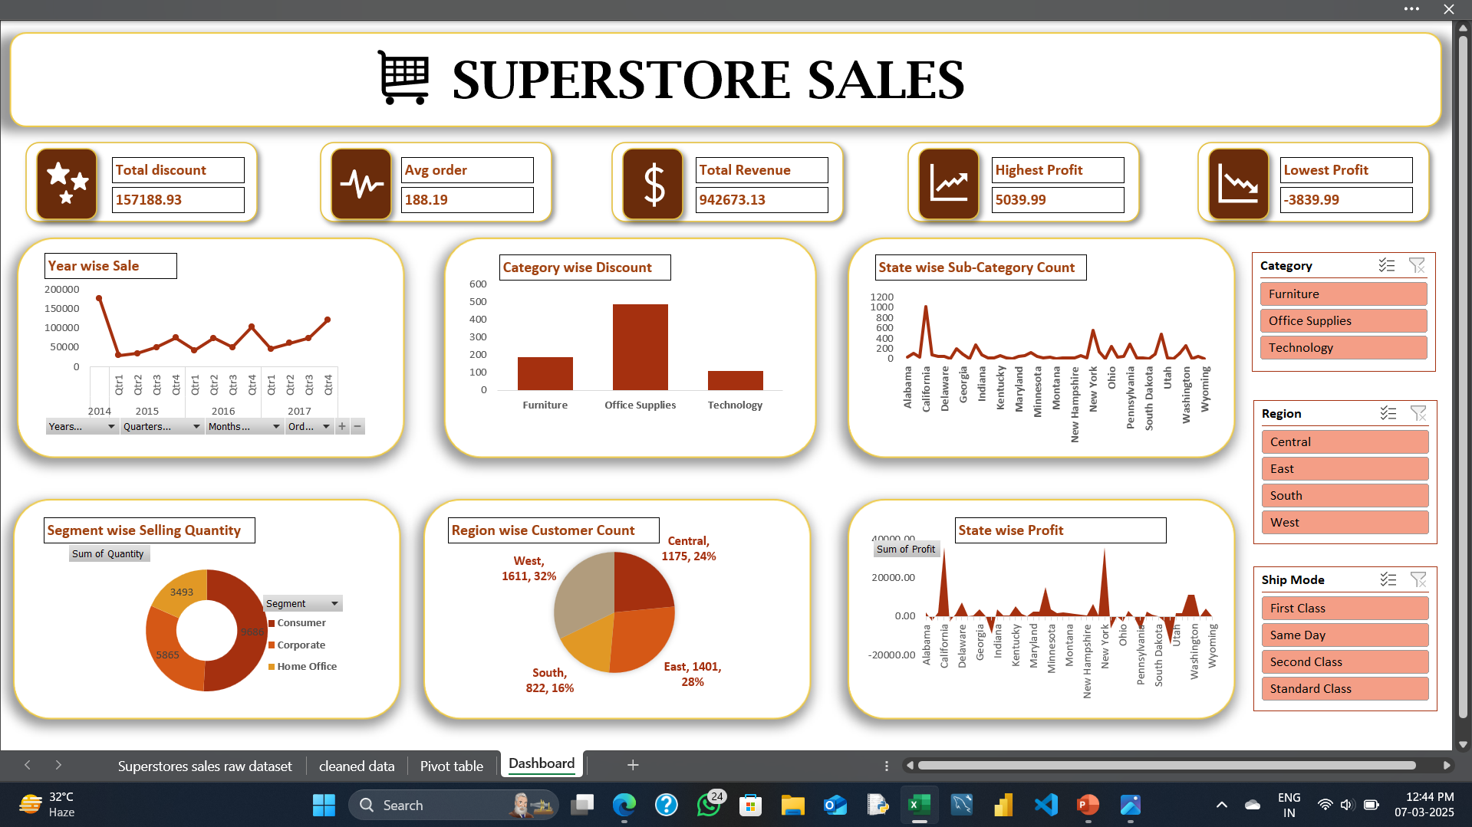
DASHBOARD
A dashboard is a visual display of key data and metrics, often used to monitor performance, track progress, and help with decision-making.
Visualized data from pivot table. Now we can make proper decision for improve the Superstore sales.

Slide 10
THANK YOU

